Slide 1


Chapter Thirteen
Optimal Compensation Systems, Deferred Compensation, and Mandatory Retirement
Prepared by Dr. Mir Ahasan Kabir
York University

Slide 2
Learning Objectives
Discuss why certain compensation arrangements that at first glance seem inefficient may be optimal mechanisms to align the incentives of employers and employees or stockholders and management.
Explain why these optimal compensation arrangements may change over time or differ across different countries or workplaces.
Outline the “new economics of personnel” and to see if it offers insights into the workplace and human resource practices of organizations.
Engage in the debate as to whether CEOs “are worth” their often astronomical pay or essentially “milking” their organization and its stockholders.
Discuss why mandatory retirement may exist and the implications of legislatively banning mandatory retirement.
© 2021 MCGRAW-HILL EDUCATION LTD.
13 - <number>

Slide 3
Main Questions
In what ways might internal labour markets within firms differ from labour markets outside of firms? What are the implications for neoclassical supply and demand models?
Why do wages rise with seniority? Does worker productivity rise continually over the life cycle?
Why are superstars paid so much more than “average” performers when the difference in their performance levels may be relatively small?
Compensation structures often resemble tournaments where individuals compete for top prizes. Can this type of competition ever be counter-productive?
© 2021 MCGRAW-HILL EDUCATION LTD.
13 - <number>

Slide 4
Main Questions
What is mandatory retirement? Does it represent age discrimination, or might it be an important feature of a well-functioning labour market?
Why are the salaries of some CEOs and executives very high, and why has their pay, relative to the pay of an average worker, increased in recent years?
Why does academic tenure exist? Should it?
Under what circumstances would organizations match the outside offers of raiding firms?
When should firms promote from within, and when should they recruit from outside of the firm?
© 2021 MCGRAW-HILL EDUCATION LTD.
13 - <number>

Slide 5
Agency Theory and
Efficiency Wage Theory
Agency Theory
The framework applied is the principal agent problem:
  Deals with the problem of designing an efficient contract between the principal and the agent when there are incentives to cheat
  Problems rise with asymmetric information
  Eliciting a “truth-telling” contract
  Examples of such contracts are collective agreements or implicit contracts
© 2021 MCGRAW-HILL EDUCATION LTD.
13 - <number>

Slide 6
Agency Theory and
Efficiency Wage Theory
Efficiency Wage Theory
  Wages affect productivity
  Wages are being paid according to value of marginal product of labour
  Emphasizes that subsistence wage is necessary for basic levels of nutrition, reproduction, and higher productivity
  The result of higher wages is efficiency gains
© 2021 MCGRAW-HILL EDUCATION LTD.
13 - <number>

Slide 7
Economics of Superstars
Small differences in the skill input of certain individuals may get magnified incredibly in the value of marginal product of the service consumed by the public or co-workers in certain circumstances (ex. concert, TV show)
A small positive effect on each person can accumulate into a large total effect when the number of affected persons in the organization is large (ex. executives, talented individuals)
© 2021 MCGRAW-HILL EDUCATION LTD.
13 - <number>

Slide 8
Salaries as Tournament Prizes
Promotion based on being the best (of several executives with seemingly equal ability), results in a huge increase in the salary
  Treated as prize of winning a contest
  Based on capability
  Increases the incentive to perform
  Important to senior persons who have few promotional opportunities left
  Discourages cooperative behaviour
  Fosters corruption
© 2021 MCGRAW-HILL EDUCATION LTD.
13 - <number>

Slide 9
Efficient Pay Equality, Teams, and Employee Cooperation
Inequality of pay is necessary to provide an incentive to perform well
Too much inequality is not efficient since it:
  Discourages cooperative behaviour and teamwork
  Encourages sabotage
Solution:
    Different pay incentive schemes for different levels within an organization
    Higher-level managers’ bonuses on the basis of group output
    Separate business units
    External promotion
    Human resources policies to encourage cooperative behaviour
© 2021 MCGRAW-HILL EDUCATION LTD.
13 - <number>

Slide 10
Efficient Pay Equality, Teams, and Employee Cooperation
The 1/N Problem
Paying people on the basis of the average performance of team members
“Free rider” problem
  Large team – little incentive
  Small team – Peer pressure
© 2021 MCGRAW-HILL EDUCATION LTD.
13 - <number>

Slide 11
Efficient Pay Equality, Teams, and Employee Cooperation
Up-or-Out Rules
  Under such rules employees are evaluated usually at a specified point in their career and either promoted or terminated (e.g. tenure at universities)
  Appears to be inefficient practice that causes loss of workers with lower productivity
Solution
  Using junior non-promoted slots to evaluate new candidate
© 2021 MCGRAW-HILL EDUCATION LTD.
13 - <number>

Slide 12
Efficient Pay Equality, Teams, and Employee Cooperation
Raiding, Offer-Matching, and the Winner’s Curse
Asymmetric information issues give rise to organizations engage in raiding other organizations for top talent
The organization being raided
  Would offer-matching of the outside offer if the person were truly worth that amount
  Would not match the offer if the person were not worth that amount.
  The raiding organization suffer from the “Winner’s Curse”
© 2021 MCGRAW-HILL EDUCATION LTD.
13 - <number>

Slide 13
Efficient Pay Equality, Teams, and Employee Cooperation
Piece Rates: workers are paid based on the output they produce.
Benefits:
  Workers producing more output
  Systems attracting good workers
  Save on the cost of monitoring
Drawbacks:
  Harder to monitor output of an individual
  Costly
  Harder to sustain the system if the individual does not have a large degree of control over the output
© 2021 MCGRAW-HILL EDUCATION LTD.
13 - <number>

Slide 14
Deferred Wages
Wages above an individual’s productivity:
  Senior employees
  Wages rise with seniority independently of productivity
  Wage increase and pension accrual for each additional year of work
Characteristics:
  Exist only if there is a long-term commitment on the part of the firm to continue the contracted arrangements
© 2021 MCGRAW-HILL EDUCATION LTD.
13 - <number>

Slide 15
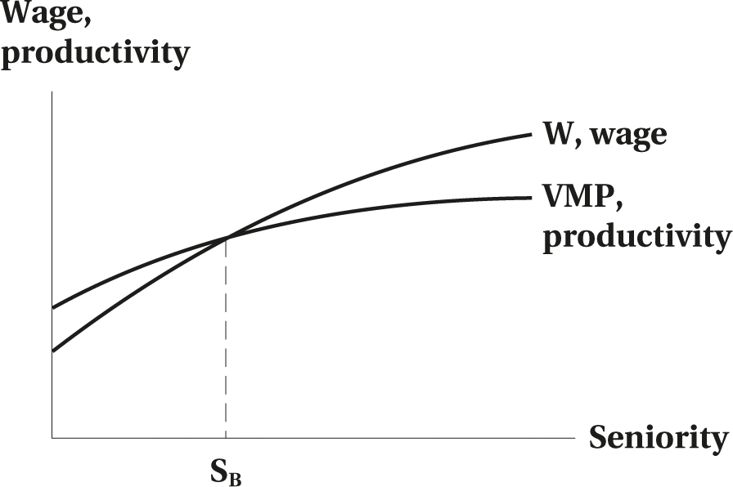
Deferred Wages
(a) Deferred wages contract market
Figure 13.1 Wage Productivity Profiles
© 2021 MCGRAW-HILL EDUCATION LTD.
13 - <number>

Slide 16
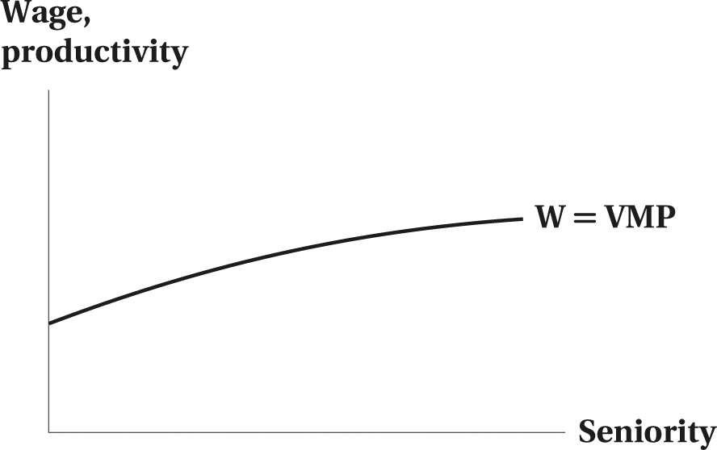
Deferred Wages
(b) Spot market
Figure 13.1 Wage Productivity Profiles
© 2021 MCGRAW-HILL EDUCATION LTD.
13 - <number>

Slide 17
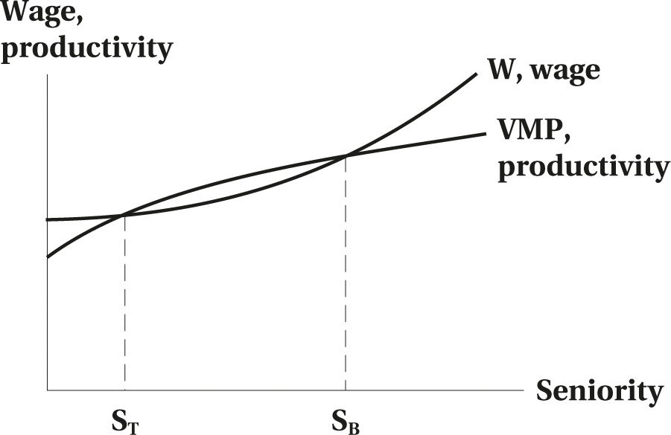
Deferred Wages
(c) Deferred wages with company--specific training
Figure 13.1 Wage Productivity Profiles
© 2021 MCGRAW-HILL EDUCATION LTD.
13 - <number>

Slide 18
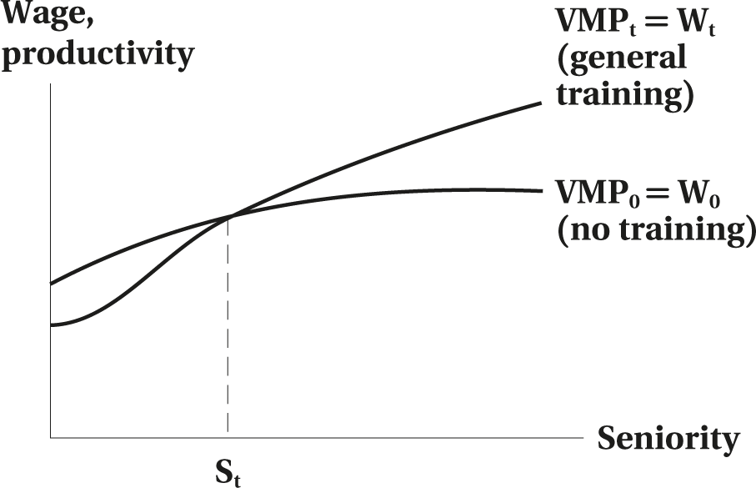
Deferred Wages
(d) General training
Figure 13.1 Wage Productivity Profiles
© 2021 MCGRAW-HILL EDUCATION LTD.
13 - <number>

Slide 19
Rationales for Deferred Compensation
Efficiency rationale:
  Increases work honesty and effort
  Reduces the need for constant everyday monitoring
  Reduces unwanted turnover
  Reduces fixed hiring and training costs
  Discourages bad workers
© 2021 MCGRAW-HILL EDUCATION LTD.
13 - <number>

Slide 20
Rationales for Deferred Compensation
WORKED EXAMPLE
Deferred Compensation
Assume a worker’s VMP, is $10 per hour
Assume that she is paid according to a deferred compensation system W = 5 + 0.2T
Assume further that she starts working with the firm at age 20, and that there is no discounting.
© 2021 MCGRAW-HILL EDUCATION LTD.
13 - <number>

Slide 21
Rationales for Deferred Compensation
Calculate at which age (or how many years tenure) the workers break even?
  Set W = VMP; that is, 5 + 0.2T = 10, or T = 25
Solve for the mandatory retirement age
  45 + 25 =70
© 2021 MCGRAW-HILL EDUCATION LTD.
13 - <number>

Slide 22
Rationales for Deferred Compensation
Age | Tenure, T | VMP | W = 5 + 0.2T | W − VMP
20 | 0 | 10 | 5 | −5
30 | 10 | 10 | 7 | −3
40 | 20 | 10 | 9 | −1
50 | 30 | 10 | 11 | +1
60 | 40 | 10 | 13 | +3
70 | 50 | 10 | 15 | +5
Underpayment or Overpayment
© 2021 MCGRAW-HILL EDUCATION LTD.
13 - <number>

Slide 23
Rationales for Deferred Compensation
WORKED EXAMPLE
Piece Rates and Team Compensation
 |  | Disutility of Effort |  | Pay (wage × effort)
Unit of effort = output (1) | Wage per unit of effort (2) | You (3) | EI Slacker (4) | You (5) | EI Slacker (6)
1 | 10 | 5 | 7 | 10 | 10
2 | 10 | 6 | 8 | 20 | 20
3 | 10 | 7 | 9 | 30 | 30
4 | 10 | 8 | 10** | 40 | 40
5 | 10 | 9 | 11 | 50 | 50
6 | 10 | 10** | 12 | 60 | 60
7 | 10 | 11 | 13 | 70 | 70
© 2021 MCGRAW-HILL EDUCATION LTD.
13 - <number>

Slide 24
Do workers also prefer deferred wages?
Researchers observed that workers preferred the rising wage profiles
They regard them as forced saving
They get satisfaction for anticipating future consumption
Individuals seemed to give up current wages in return for future wages
© 2021 MCGRAW-HILL EDUCATION LTD.
13 - <number>

Slide 25
Executive Compensation
Executive pay has increased relative to the average pay of workers
Executive compensation consists of a base salary and stock options
Compensation process involves the board of directors who have an incentive to award high executive salaries because they are themselves executives
© 2021 MCGRAW-HILL EDUCATION LTD.
13 - <number>

Slide 26
Rationale for Mandatory Retirement
To enable deferred wages
As a result the expected present value of the wage stream is equal to the expected present value of the productivity stream to the firm
Gives finality to the existing contractual arrangement
Efficient compensation rule
Opens up promotion and employment opportunities for younger workers
Creates a greater degree of certainty about the date of retirement
For employers: facilitate planning for new stuffing requirements, pension obligations, and medical expenditures
For workers: encourages pre-retirement planning
Reduces the cost of monitoring of older workers
© 2021 MCGRAW-HILL EDUCATION LTD.
13 - <number>

Slide 27
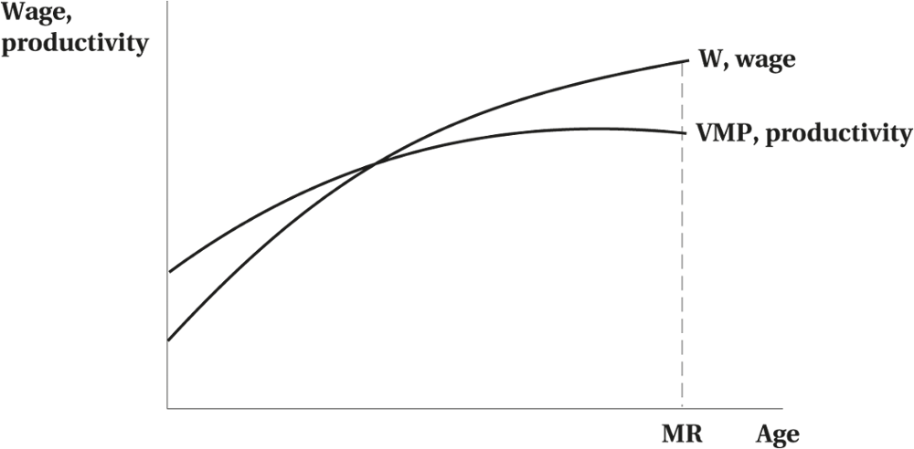
Rationale for Mandatory Retirement
Figure 13.2 Mandatory Retirement Age
© 2021 MCGRAW-HILL EDUCATION LTD.
13 - <number>

Slide 28
Rationale for Mandatory Retirement
Arguments Against Mandatory Retirement
Human rights issues (a form of age discrimination)
If one is able, wants to continue, and capable of working productively, they will still not be able to do so (efficiency-loss)
Improving the viability of public and private pensions
© 2021 MCGRAW-HILL EDUCATION LTD.
13 - <number>

Slide 29
Rationale for Mandatory Retirement
Impact of Banning Mandatory Retirement
Some theoretical predictions:
  Changing the age earning profile to coincide with productivity (higher wages for younger workers and lower wages for older workers)
  Possible changes of deferred wages systems
  Possible Increase in the monitoring and evaluation of workers
  Reduction in the employment opportunities for younger workers
  Reduction in training
  More difficult forecasting and planning
  Possible redesigning of jobs to accommodate older workers
© 2021 MCGRAW-HILL EDUCATION LTD.
13 - <number>

Slide 30
Chapter Summary
Agency and Efficient Wage Theories
Economics of Superstars
Salaries as Tournament Prizes
Inequality in Pay
Up-or-Out Rule: Drawbacks and Resolution
Piece Rates: Positives and Negatives
Executive Compensation
Deferred Wages: Characteristics and Rationale
Mandatory Retirement: Rationales, Impact, and Causes
© 2021 MCGRAW-HILL EDUCATION LTD.
13 - <number>

